Slide 1

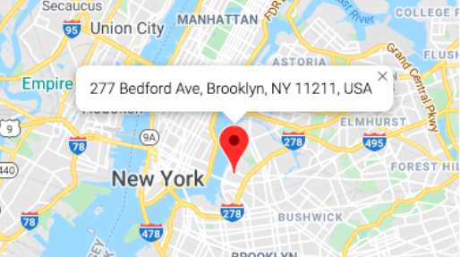

















User Name
Inspection Type
Address
Inspection Description
New Inspection
10:00
REQ-N
Set Alarm
Inspection Type
Address
277 Bedford Ave, Brooklyn
NY 11211, USA
Inspectors
277 Bedford Ave, Brooklyn
NY 11211, USA
Inspection Description
Inspection Trends
10:00
REQ-N
Description: Suite 102: tenant improvement of 2,026 square feet on ground floor.
Description: Suite 102: tenant improvement of 2,026 square feet on ground floor.
Board Meeting
Inspection Type
Address
Estimated Arrival: 04/15/2020 at 08:00:00
Estimated Arrival: 04/15/2020 at 08:00:00
Inspection Description
Report an Issue
Last Inspector: Anthony Egson
Photos Inspection
10:00
Last Inspector: Anthony Egson
REQ-N
REQ-N: 1953824
Commentary
Inspection Type
Address
REQ-N: 1953824
Inspection Description

